Slide 1

Exploratory Data Analysis
Cab Investment
2022-10-17

Slide 2

Agenda
Executive Summary
Problem Statement
Approach
EDA
EDA Summary
Recommendations

Slide 3
Executive Summary
Task:
perform data analysis and provide insights to XYZ in order to help them with best investment possible.
Data concerning two companies, Pink Cab and Yellow Cab, were given in order to compare their business and at the end, give recommendation in which company should XYZ invest in.
XYZ, a private firm in US, is planning for an investment in Cab industry and as per their Go-to-Market(G2M) strategy they want to understand the market before taking final decision.

Slide 4
Problem Statement
And Approach
Analysis preparation:
Separate analysis of each dataset and making sure we understand the data in it
Data cleaning - removing unnecessary columns, checking if there are no misspellings or illogical values like negative price etc.
Creating additional columns (age groups from age column, income groups from income column etc)
Combining csv files and creating master dataset which will be used for further data analysis
4 main data sources:
Cab_Data.csv
Customer_ID.csv
City.csv
Transaction_ID.csv
Analysis preparation results:
No duplicated values were detected
No outliers were detected
Transaction_ID.csv contains transactions that did not appear in the main Cab_Data csv file – we lost over 80000 transaction due to incompletion of Cab_Data.csv file
External data source:
US Holiday Dates (2004-2021).csv

Slide 5
EDA – Overall business comparison
Yellow Cab:
-has 8.3 times bigger profit
-has 3.2 times greater number of drives
-has 2.6 times higher profit per km
-has 23% higher number of customers
Pink Cab:
-has lower cost per kilometer
-has 32% lower price per kilometer
Company | Profit | Number of drives | Number of unique customers | Average cost per km | Average profit per km | Average price per km
Pink Cab | 5,307,328 | 84,711 | 32,330 | 11.00 | 2.777 | 13.777
Yellow Cab | 44,020,373 | 274,681 | 39,896 | 13.2 | 7.101 | 20.301

Slide 6
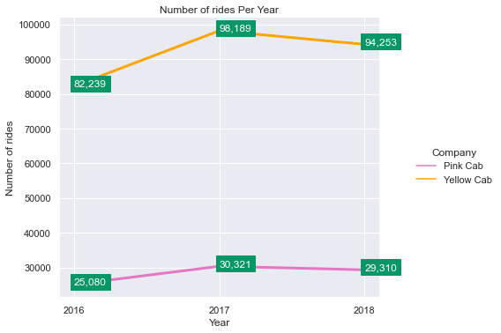
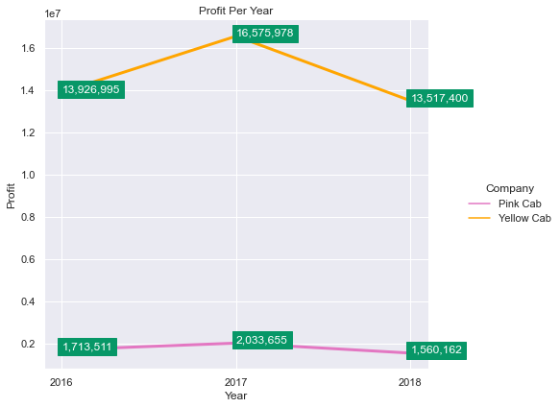
EDA – Time analysis

Slide 7
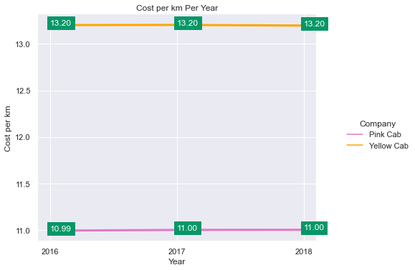
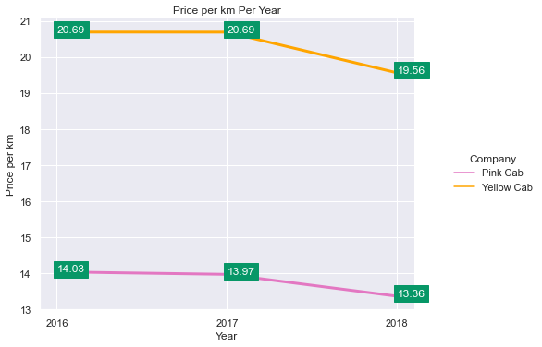
EDA – Time analysis

Slide 8
EDA – Time analysis - Conclusion
Conclusions:
Both companies had a slightly reduced number of rides in 2018
Both companies lowered their prices in 2018
Cost per km remained almost the same throughout the years for both companies
-> The result from the three above statement is the profit loss in 2018 which one of the graphs clearly shows
Additionally, Yellow Cab gained more profit in each year. Their prices were higher all the time, but they managed to maintain around three times more rides than the Pink Cab each year.

Slide 9
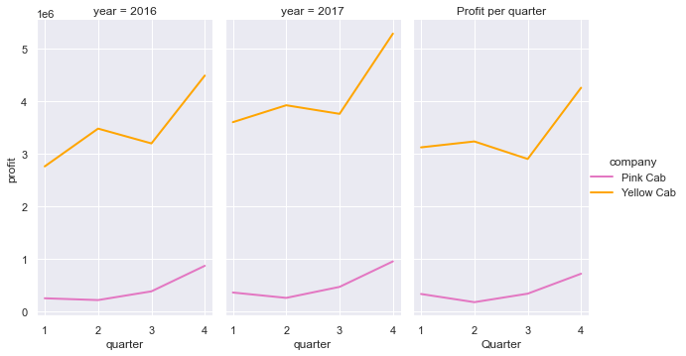
EDA – Profit Seasonality
Quarterly profit seasonality exists
There are seasonal differences between the companies - for Yellow Cab Q2 is more profitable than Q1, for Pink Cab it's less profitable than Q1

Slide 10
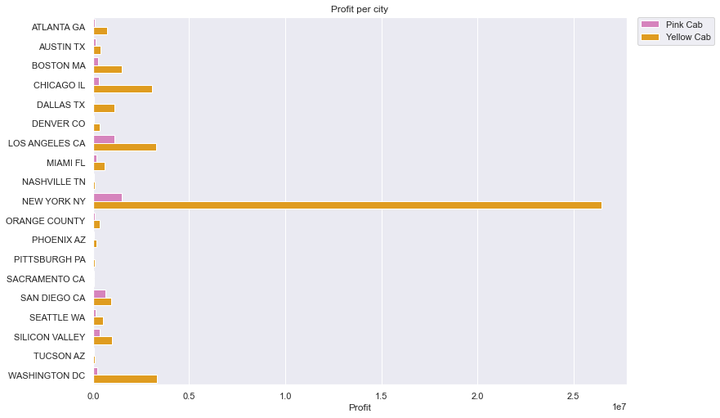
EDA – City Analysis –Profit
Marks cities where
Pink Cab has higher
Profit than Yellow Cab

Slide 11
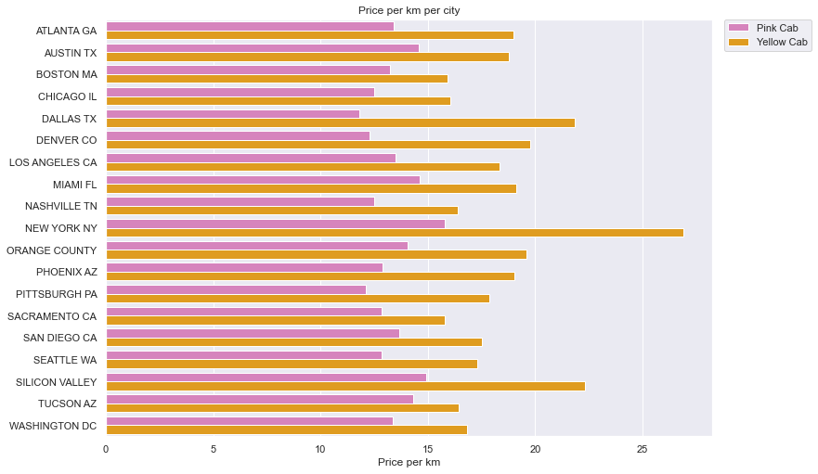
EDA – City Analysis – Price per kilometer
Marks cities where
Pink Cab has higher
Price per kilometer
than Yellow Cab

Slide 12
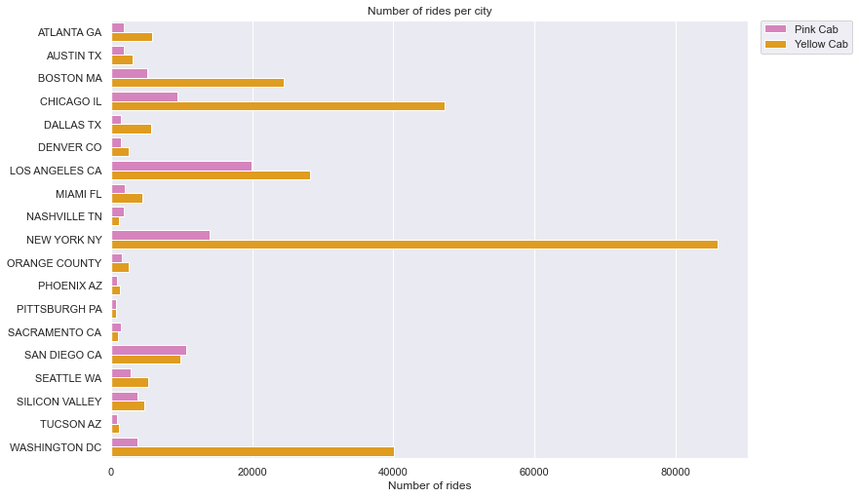
EDA – City Analysis – Number of drives
Marks cities where
Pink Cab has higher
Number of drives
than Yellow Cab

Slide 13
EDA – City Analysis – Conclusion
Conclusions:
Yellow Cab has gained more profit in all 19 cities
Yellow Cab has higher price per kilometer in all 19 cities
Yellow Cab has higher number of rides in 15/19 cities. There are only 4 cities where Pink Cab has higher number of rides

Slide 14
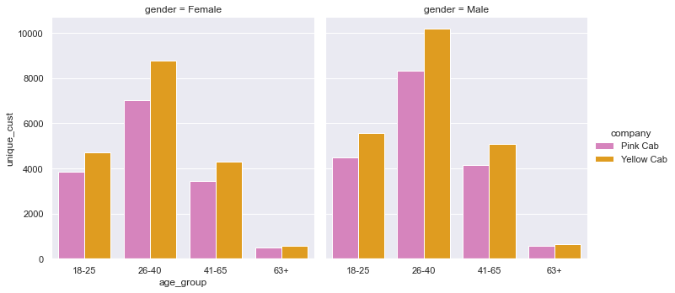
EDA – Unique Customers analysis - Gender

Slide 15
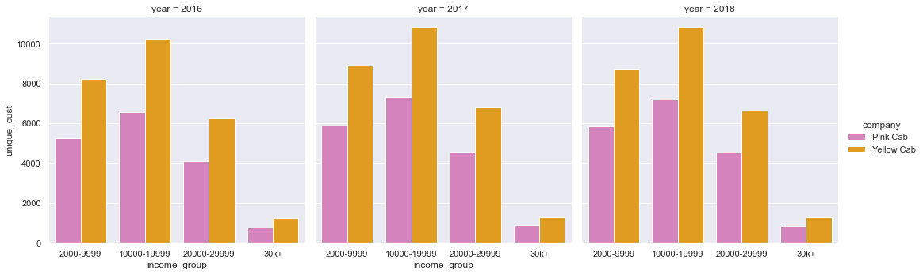
EDA – Unique Customers analysis – Income group

Slide 16
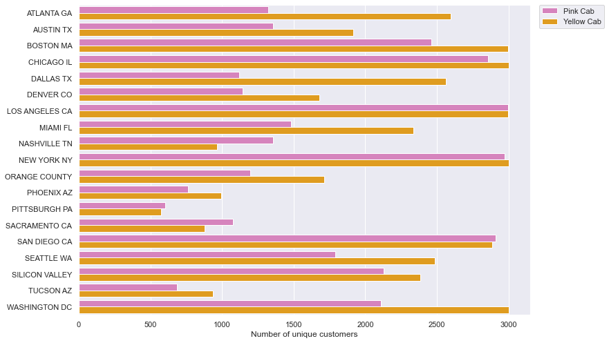
EDA – Unique Customers analysis - City
Marks cities where
Pink Cab has higher
Number of unique
customers
than Yellow Cab

Slide 17
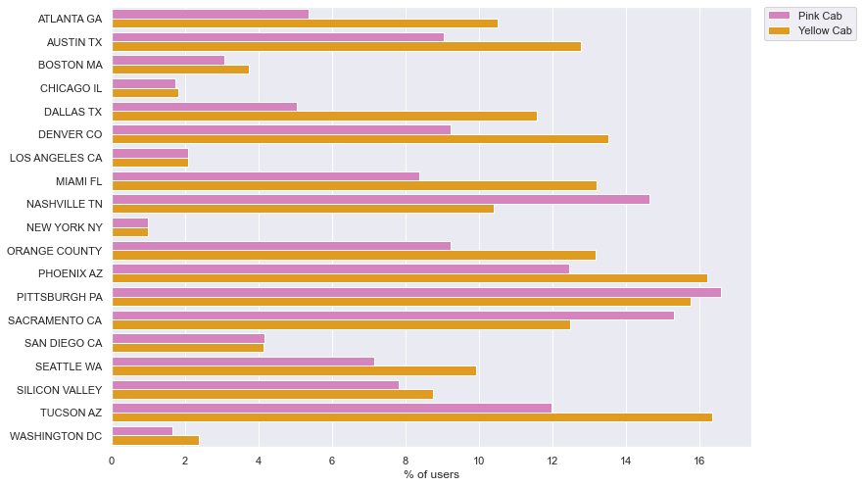
EDA – Customers % of all cab users in the city
Marks cities where
Pink Cab has higher
user percentage
than Yellow Cab

Slide 18
EDA – City Analysis – Conclusion
Conclusions:
Companies have similar distribution (in terms of percentages out of all customers that use that company) of female and male customers from each age group. Yellow Cab has overall higher number of unique customers
The 4 cities where Pink Cab has more unique customers than Yellow Cab are the same cities in which Pink Cab has more drives than Yellow Cab and the same cities where Pink Cab has higher percentage of cab users. But even in those 4 cities Yellow Cab gains more profit than Pink Cab.

Slide 19
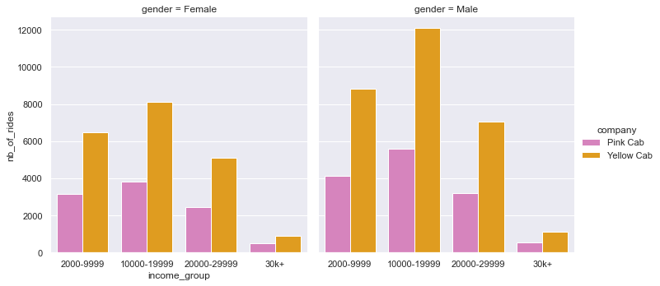
EDA – Customers who have more than 5 rides in both cab companies – Number of rides

Slide 20
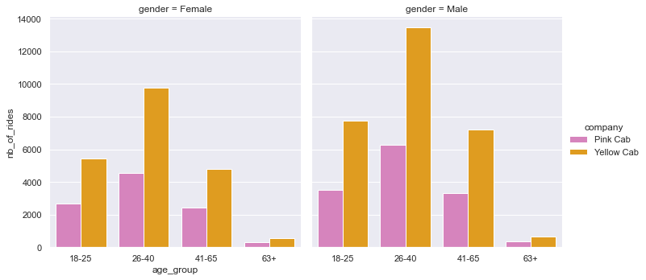
EDA – Customers who have more than 5 rides in both cab companies – Number of rides

Slide 21
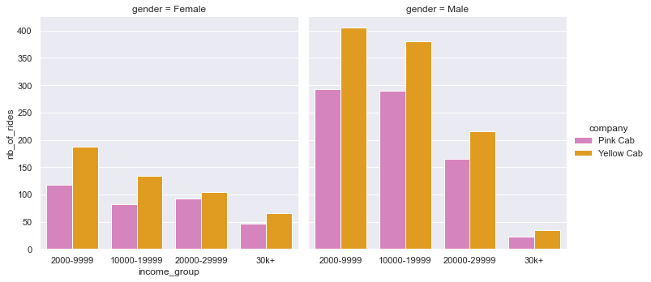
EDA – Customers who have more than 10 rides in both cab companies – Number of rides

Slide 22
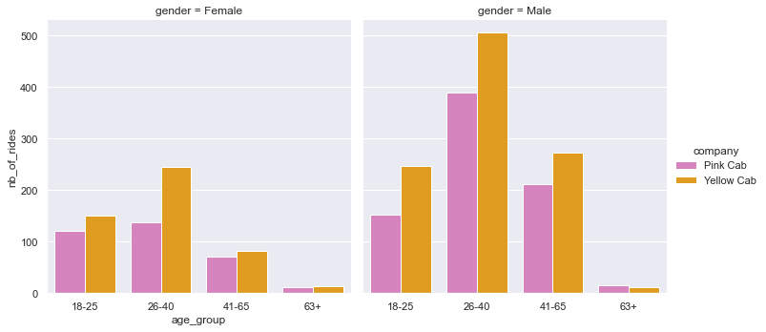
EDA – Customers who have more than 10 rides in both cab companies – Number of rides

Slide 23
EDA – Customers who have more than x rides in both cab companies
Conclusions:
Graphs show that distribution of people who have taken cabs from both companies is similar across all genders, age groups and income groups.
People who have taken cabs from both companies at least 5 times and 10 times, prefer Yellow Cab company.
There are around 20000 people who have driven with both companies at least once. Only around 3000 of them have used Pink Cab more times than Yellow Cab.

Slide 24
EDA Summary and recommendation
Conclusions:
Profit: Yellow Cab gains more than 8 times bigger profit than the Pink Cab. It gains higher profit among all age groups, income groups, cities and genders and in all of the 19 cities from the analysis.
Price per km: In all of the 19 cities Yellow Cab has up to 60% higher price per km than the Pink Cab. It is more expensive than the Pink Cab in every city.
Number of drives: Out of 19 cities, Yellow Cab has greater number of drives in 15 of them and all together has more than 3 times higher number of rides. Pink Cab has greater number of drives than Yellow Cab in 4 of the cities.
Customers: Both companies have almost equal number of customers among all genders, income groups and age groups. Even though Pink Cab has greater number of unique customers in some cities, the number of drives those customers take is drastically lower than for the yellow cab.
Customers who use both companies: There are around 20000 people who have driven with both companies at least once. Only around 3000 of them have used Pink cab more than Yellow cab.
The investment recommendation goes to the Yellow cab company

Slide 25
Thank You

